Slide 1
Show Steer Supplies Vandegrift FFA 2024 Updated April 2024

Slide 2
Timeline for steer shows
March - April – Decide on a breed 1st then a budget to work with for steer purchase.
2024 prices range from $3000 - $5000+
Look online and physically shop for animals:
https://tusacattle.com/ - HIGHLY RECOMMEND
https://steerbidder.com/
Late April: Set up pens and get ready for animal.
Pay ear tag fee (validation) and pen rent ($25-35)
May: Purchase animal
June: Tag in/ Validation: MANDATORY June 17, 2024 @ Hendrickson HS ag barn
May- December: Feed, weigh, work your animal, keep records.
January- TCYS, February (San Antonio), March (Houston)

Slide 3
Approx. Expense @ start
Up Front Cost, paid when obtaining calf:
Pen Rent - $250
Ear Tag (validation tag) $30
Calf: $3500+
Large Tack/ Supply Box for your feed, supplies and tack, you can make this. $200 (approx.)
Feed Buckets (several): $30-50
Water Trough- 17 gallon min. $35
Soap for bathing the calf: $30
Water hose (15’) and a spray nozzle: $20
Hay Bag: $6
Rope Halter(s): $8ea, BUY at least 2 – LONG LEAD ROPE
Scrub Brush: $8
Hair Comb (only for hair calves): $25
Neck Tie: $10-15
Show stick: $40
Show Halter $70
Neck Sweat- $60
Approximate Reoccurring Costs:
Feed: $15-20/ 50lb bag
Bales of Hay: $12-$15/ each
Supplements: $100+ monthly
Wormer $50+ (worm every 21 days)
Hoof Trimming (about every 8 weeks) $100

Slide 4
Items Needed at the beginning
Tack/ Supply Box for your feed, supplies and tack, you can make this at home.
Feed Buckets (2) - https://www.sullivansupply.com/product/smart-feed-pan/
Waterer- needs full water 24/7 https://www.tractorsupply.com/tsc/product/fortiflex-large-capacity-plastic-bucket-175-gal?cm_vc=-10005
Soap for bathing the calf – Orvus Paste is the best soap for show animals. Split the cost of this- use a very small amount, a little goes a long way!
Hay Bag: https://www.sullivansupply.com/product/hay-bag/
Rope Halter: https://www.sullivansupply.com/product/rope-halter/
Scrub Brush: https://www.sullivansupply.com/product/massage-brush/
Hair Comb (only for hair calves):
Neck Sweat: https://www.sullivansupply.com/product/black-heat-neck-sweat/
Neck Tie: https://www.sullivansupply.com/product/neck-tie/
Show stick – IMPORTANT- YOU WILL NEED 2! Get one that fits you. 54” is common, 60” if you are short ☺: https://www.sullivansupply.com/product/54-superstick-show-stick/

Slide 5
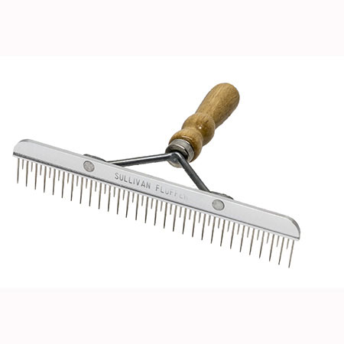
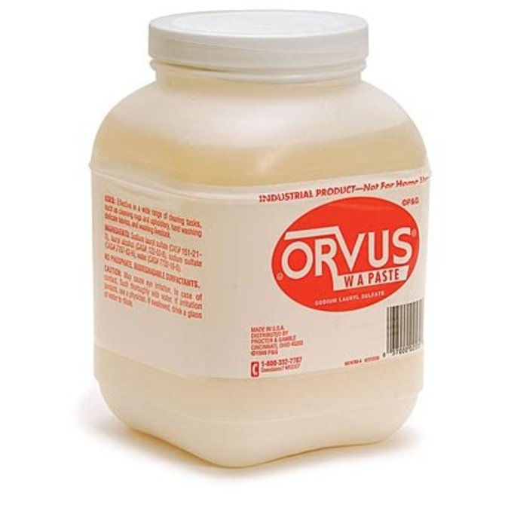
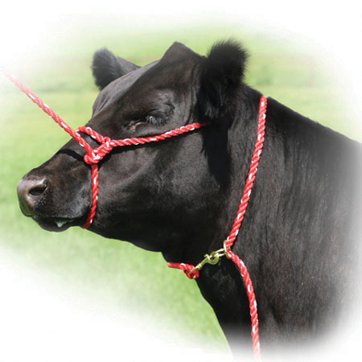
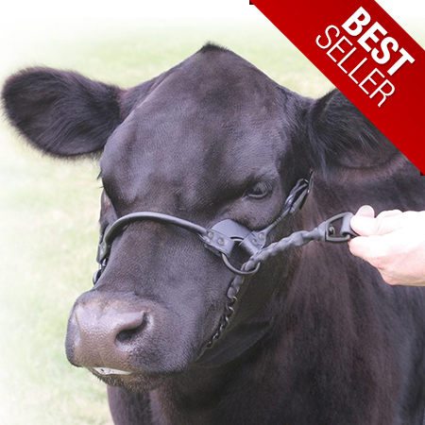
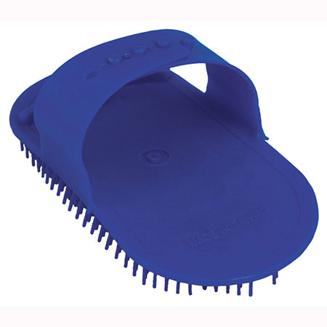
Items Needed Examples
Washing Soap- SHARE EXPENSE!!
Comb- Hair cattle only
Rope Halter
Neck Tie
Show Halter
Brushes- 1 to wash with (scrubber), 1 to brush their hair

Slide 6
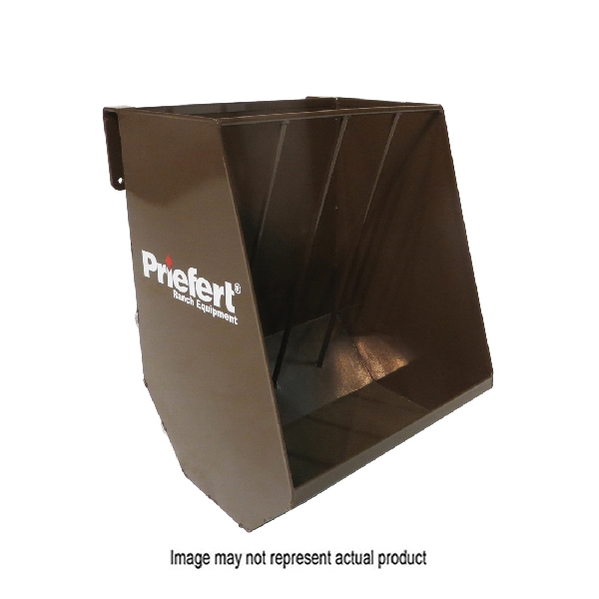
In pen feed trough
May need to order from McCoys or other Priefert Dealer
https://www.mccoys.com/shop/p/06032030/priefert-hgfgn-hay-and-grain-feeder-sheet-metalsteel-green-powder-coated

Slide 7
Items Needed for Shows
Show Halter, They come in different sizes https://www.sullivansupply.com/product/1st-class-show-halter/
Neck Tie -
Exhibitor Harness- https://www.sullivansupply.com/product/exhibitor-harness/
Show Stick
Feed Bucket- https://www.tractorsupply.com/tsc/product/tuff-stuff-products-heavy-duty-feed-pan-7-gal?cm_vc=-10005
The following items are not required but if you raise cattle for 1+ years:
Blower - https://www.sullivansupply.com/product/air-express-iii/
Show Box - https://www.sullivansupply.com/product/4ft-steel-upright-dolly-box/
24” Fan - https://www.sullivansupply.com/product/24-turbo-fan/
Clippers - https://www.sullivansupply.com/product/lister-star-clipper-wblades-case/

Slide 8
MEDICATION
Have Mineral Oil (CVS, Walgreens) on hand at all times – helps control bloat.
Probios – microbe supplement (1 tube will go a long way because it is on an “as needed” basis.
If you notice your animal with a cough, yellowish mucus in their nose, let Mr. Lemmons know ASAP.

Slide 9
Wormer
Give Wormer on 21 day cycles (every 3 weeks, set reminder in your phone)
Wormer is expensive, so SHARE the COST with other cattle exhibitors! 1 bottle will last you the duration of a steer project, but you need to alternate wormer to keep them effective
Cydectin, Safe-Guard, Valbazen, are all good wormers.
Rotate wormers every 2 months (Example: use cydectin for 2 cycles, then switch to Valbazen)
Drenching (orally) is the most effective way to administer, but Alcohol based wormers can be poured along the backline (easiest).

Slide 10
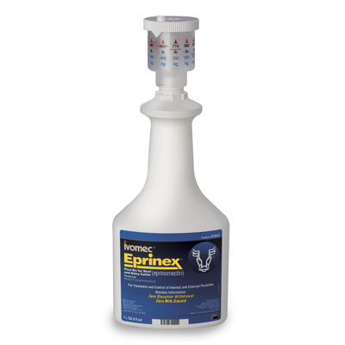
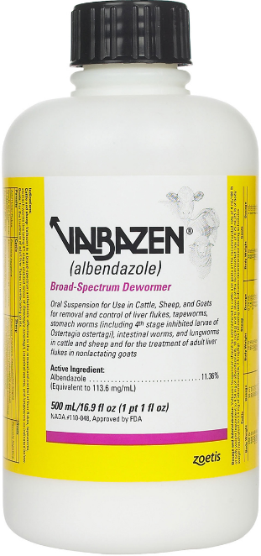
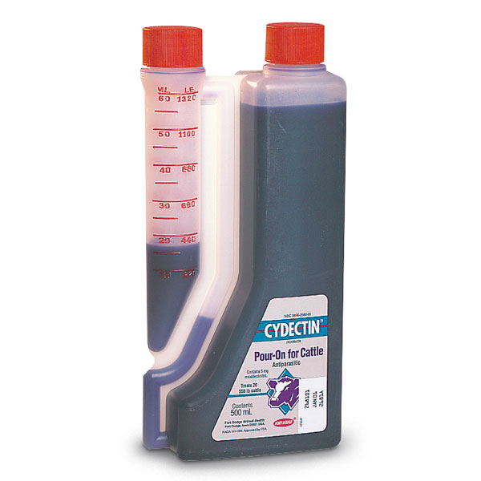
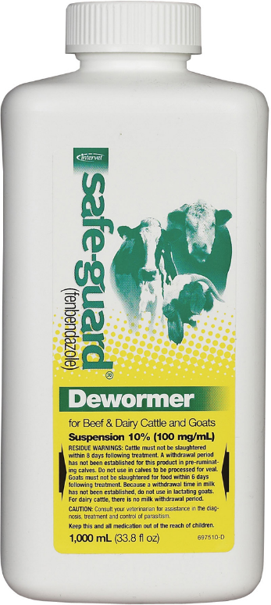
Wormer

Slide 11
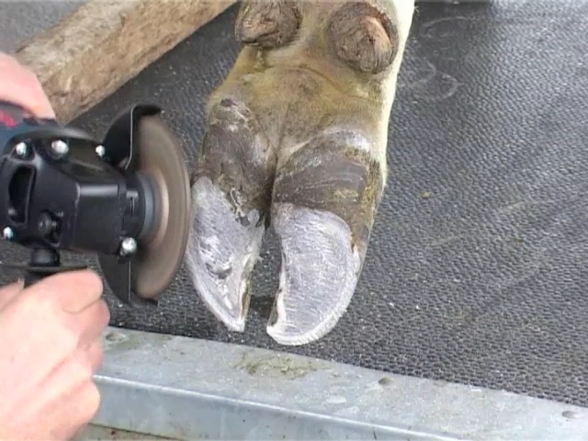
Hoof Trimming
Basically a mani/pedi
Every 6-8 weeks.
Budget at least $100- $150 per occurrence
It can be helpful to correct structure issues (if present)
Needed to help fit hooves to proper angle and set up.
Either we will take the animals to get trimmed or the hoof trimmer will come to us.

Slide 12
FEED Companies
Call at least a day before you can go pick up feed to make sure they have what you need in stock
Producers CO-OP in New Braunfels
1744 S. Seguin Ave. 78130 Phone: 830-625-2381
Lucherk Grower $14 - $18/ bag
Purina Honor Show Feed
Hill Country Feed- Leander, 512-259-1658
Purina Full Range $ 19 - $23/ bag
Supplements (used in small amounts)
Emmert Show Bloom
VitaFerm Concept Aid Mineral - Hutto Feed - 512-642-3522

Slide 13
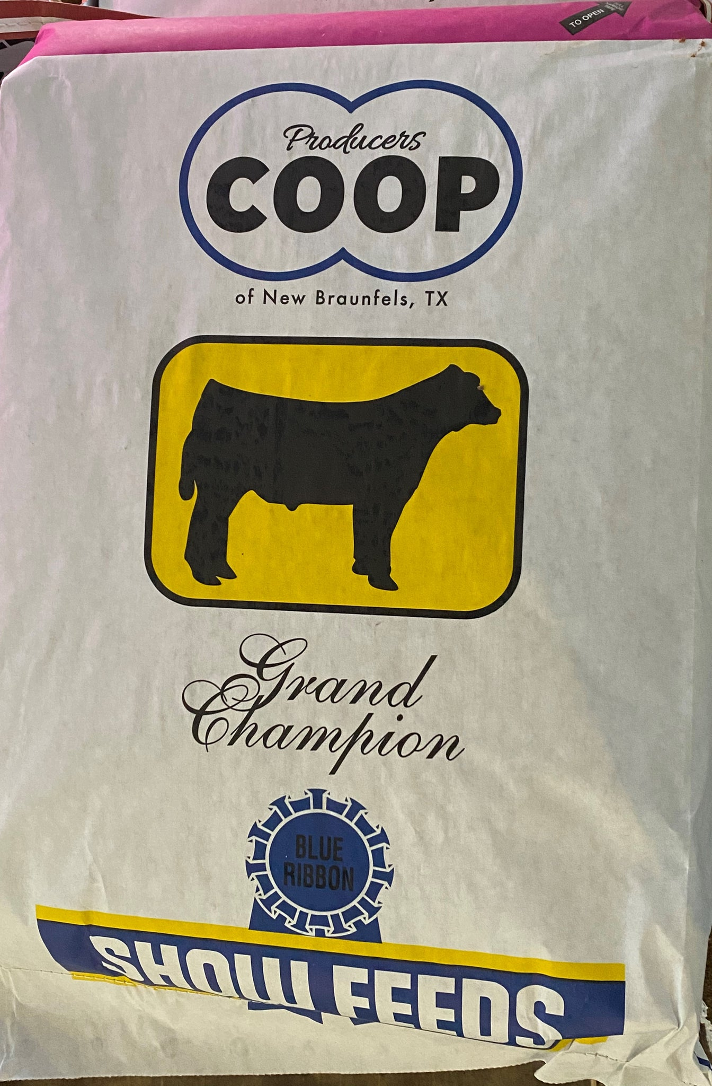
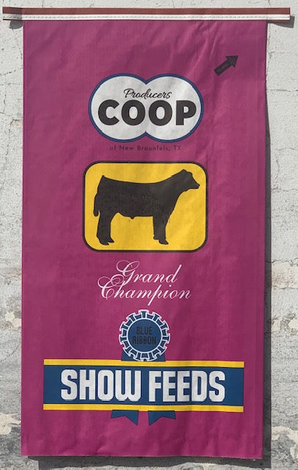
FEED
Lucherk Special Reserve - Finisher
Purina Honor Full Range - Grower
Lucherk Select Starter/Grower
Emmert- Show Bloom
VitaFerm – Concept Aid Mineral

Slide 14
Reminders
Check weight every 2 weeks on the same day – set a reminder in your phone
FRESH FEED AND WATER DAILY!!!
Avoid any sudden changes in regiment, gradually change the ration over a period of a week or so

