Slide 1
Raising a show pig: Equipment, Supplies, General Information
Vandegrift FFA

Slide 2
What do I need?
Supply / Tack Box
Feed Scoop
Show Sticks
Feed Bucket
Brushes
Clip on or hanging Feeder
Other items listed in this ppt
ALL of these items can be found at local feed stores, Tractor Supply or online at Sullivans show supplies.

Slide 3
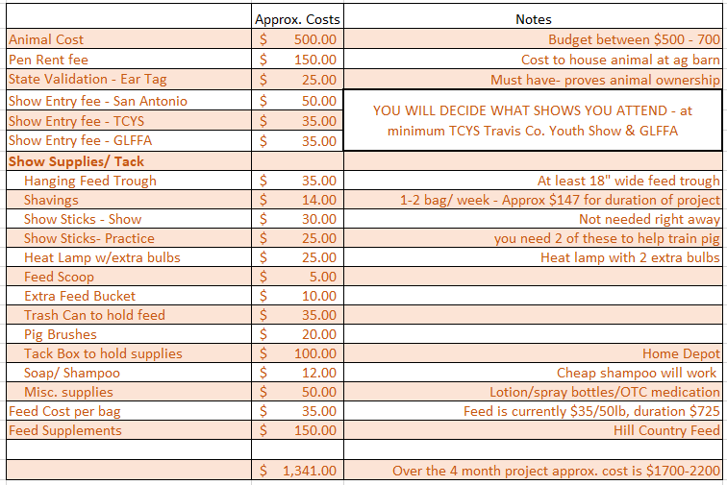
Approximate Costs
Costs above are variable, but this is an estimate of what the project will cost over the term of 4 months.
The point is to make some money back by placing with your animal in livestock shows
Some students seek sponsors for costs associated with raising animals

Slide 4
What’s included in your pen rent fee:
A secure area for your animal.
1 gate card for ag barn access
Electricity and water for duration of project
A pen to house animal
Waterer in each pen to drink from
Practice arena to train, work and hone your animal showing skills
Blowers and Grooming supplies when needed (animal specific)
Lockers are available for use
Trailers and truck cages to haul animals to shows, veterinary and tag-in.
Light medication if needed.
*Ag Teacher can haul animals in the event a veterinarian is needed. Veterinary bills are the responsibility of animal owner.
Tools Provided
Water hoses
Brooms
Shovels
Rakes
Wheelbarrows
Trash cans for barn trash
Containment area for used/ dirty shavings and manure
Dumpster for barn trash
Trailers to haul animals to shows

Slide 5
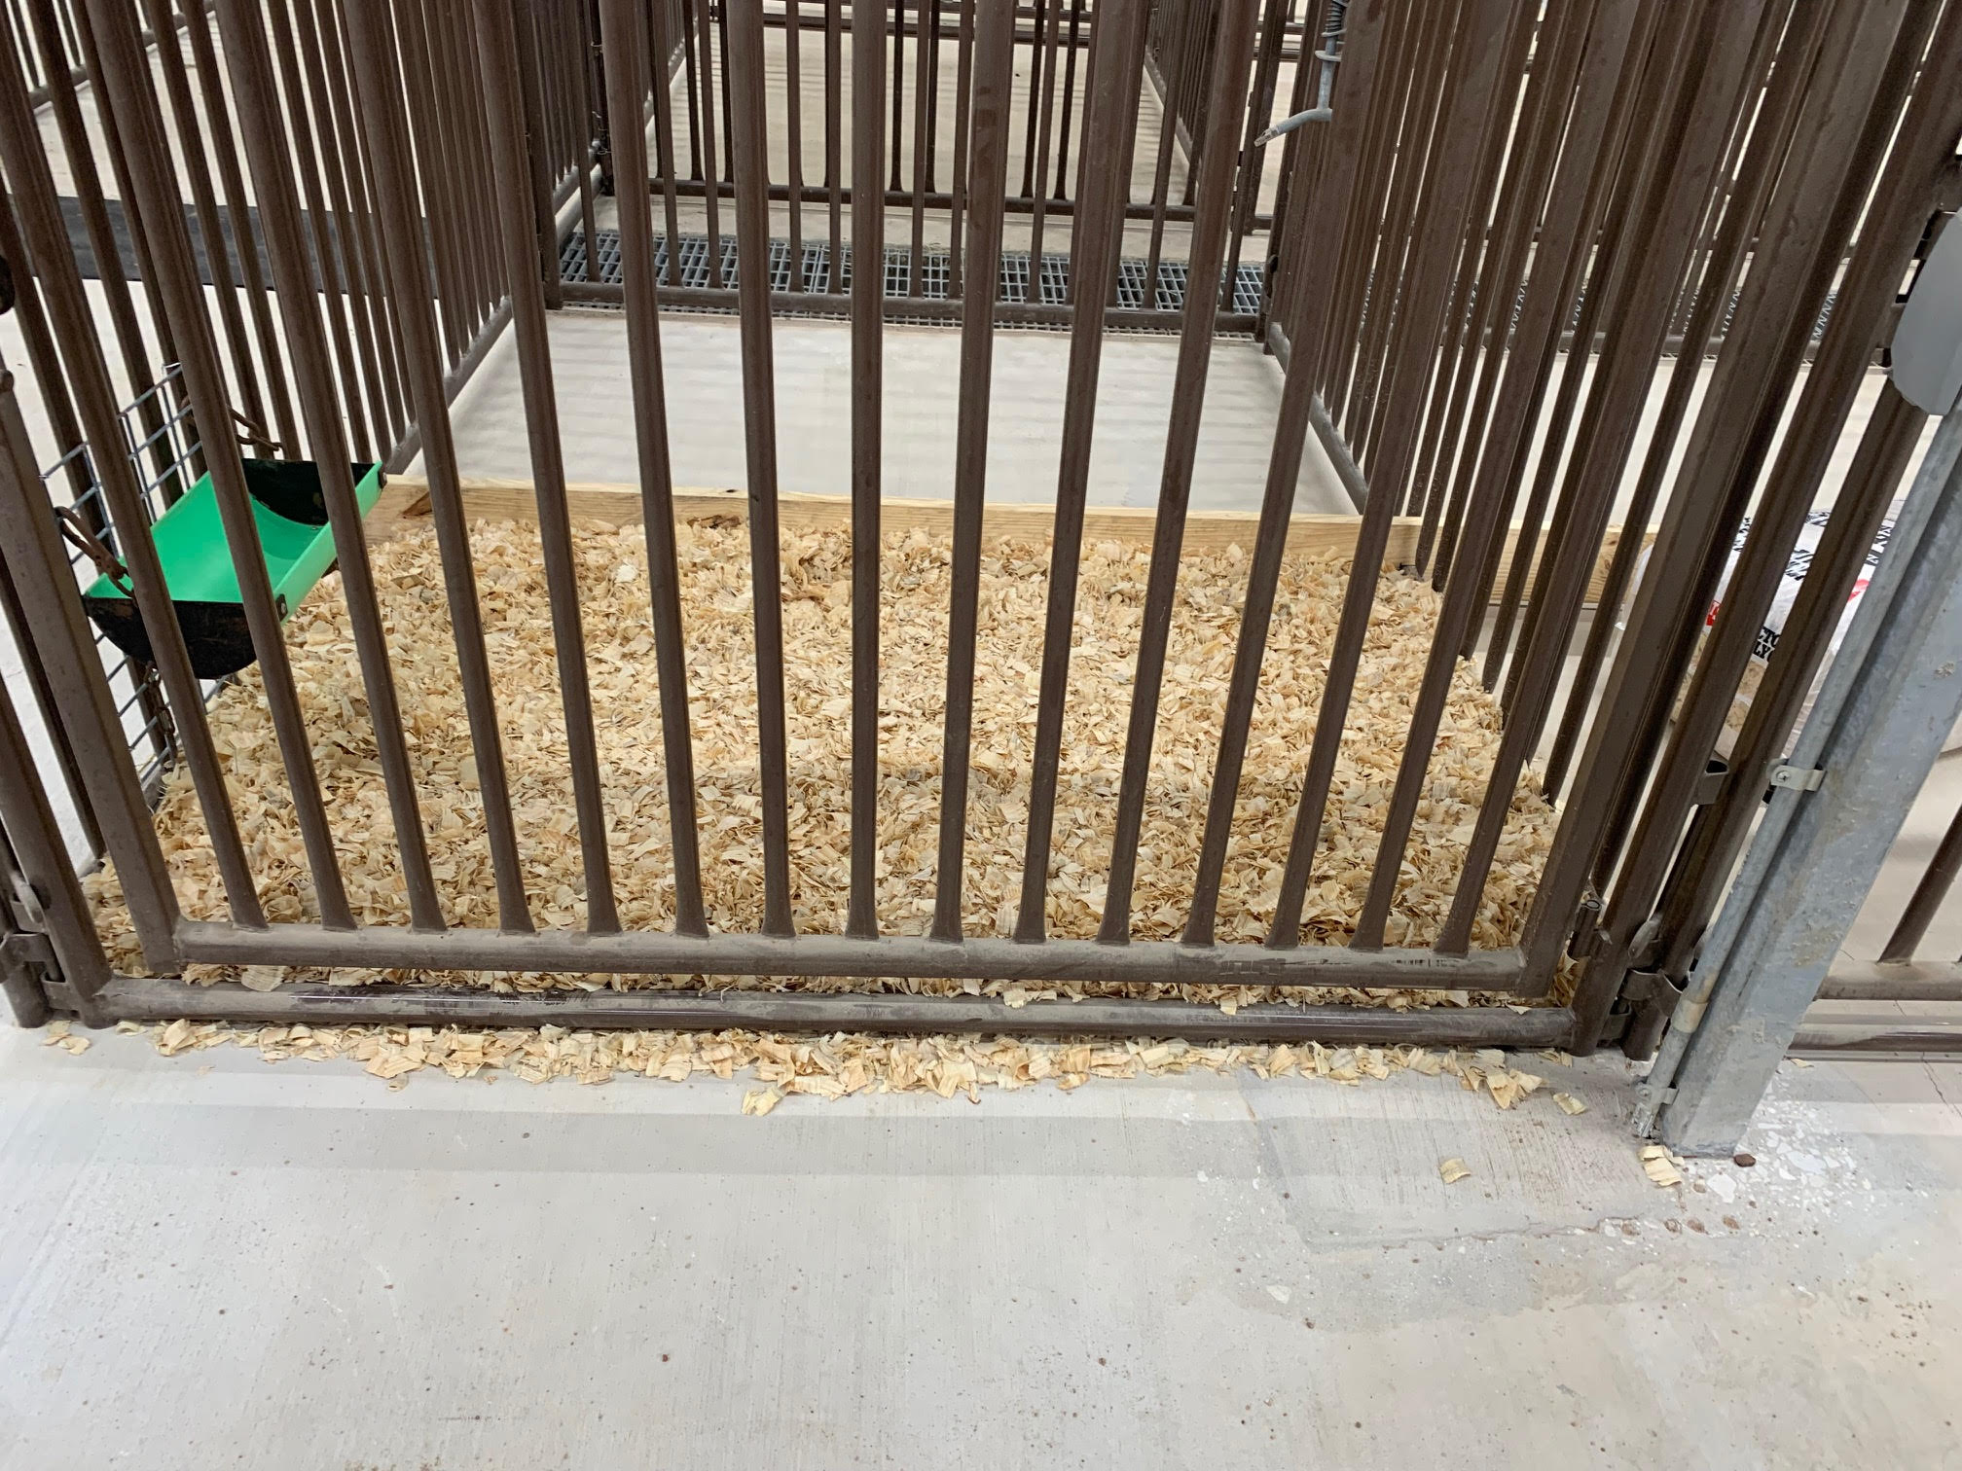
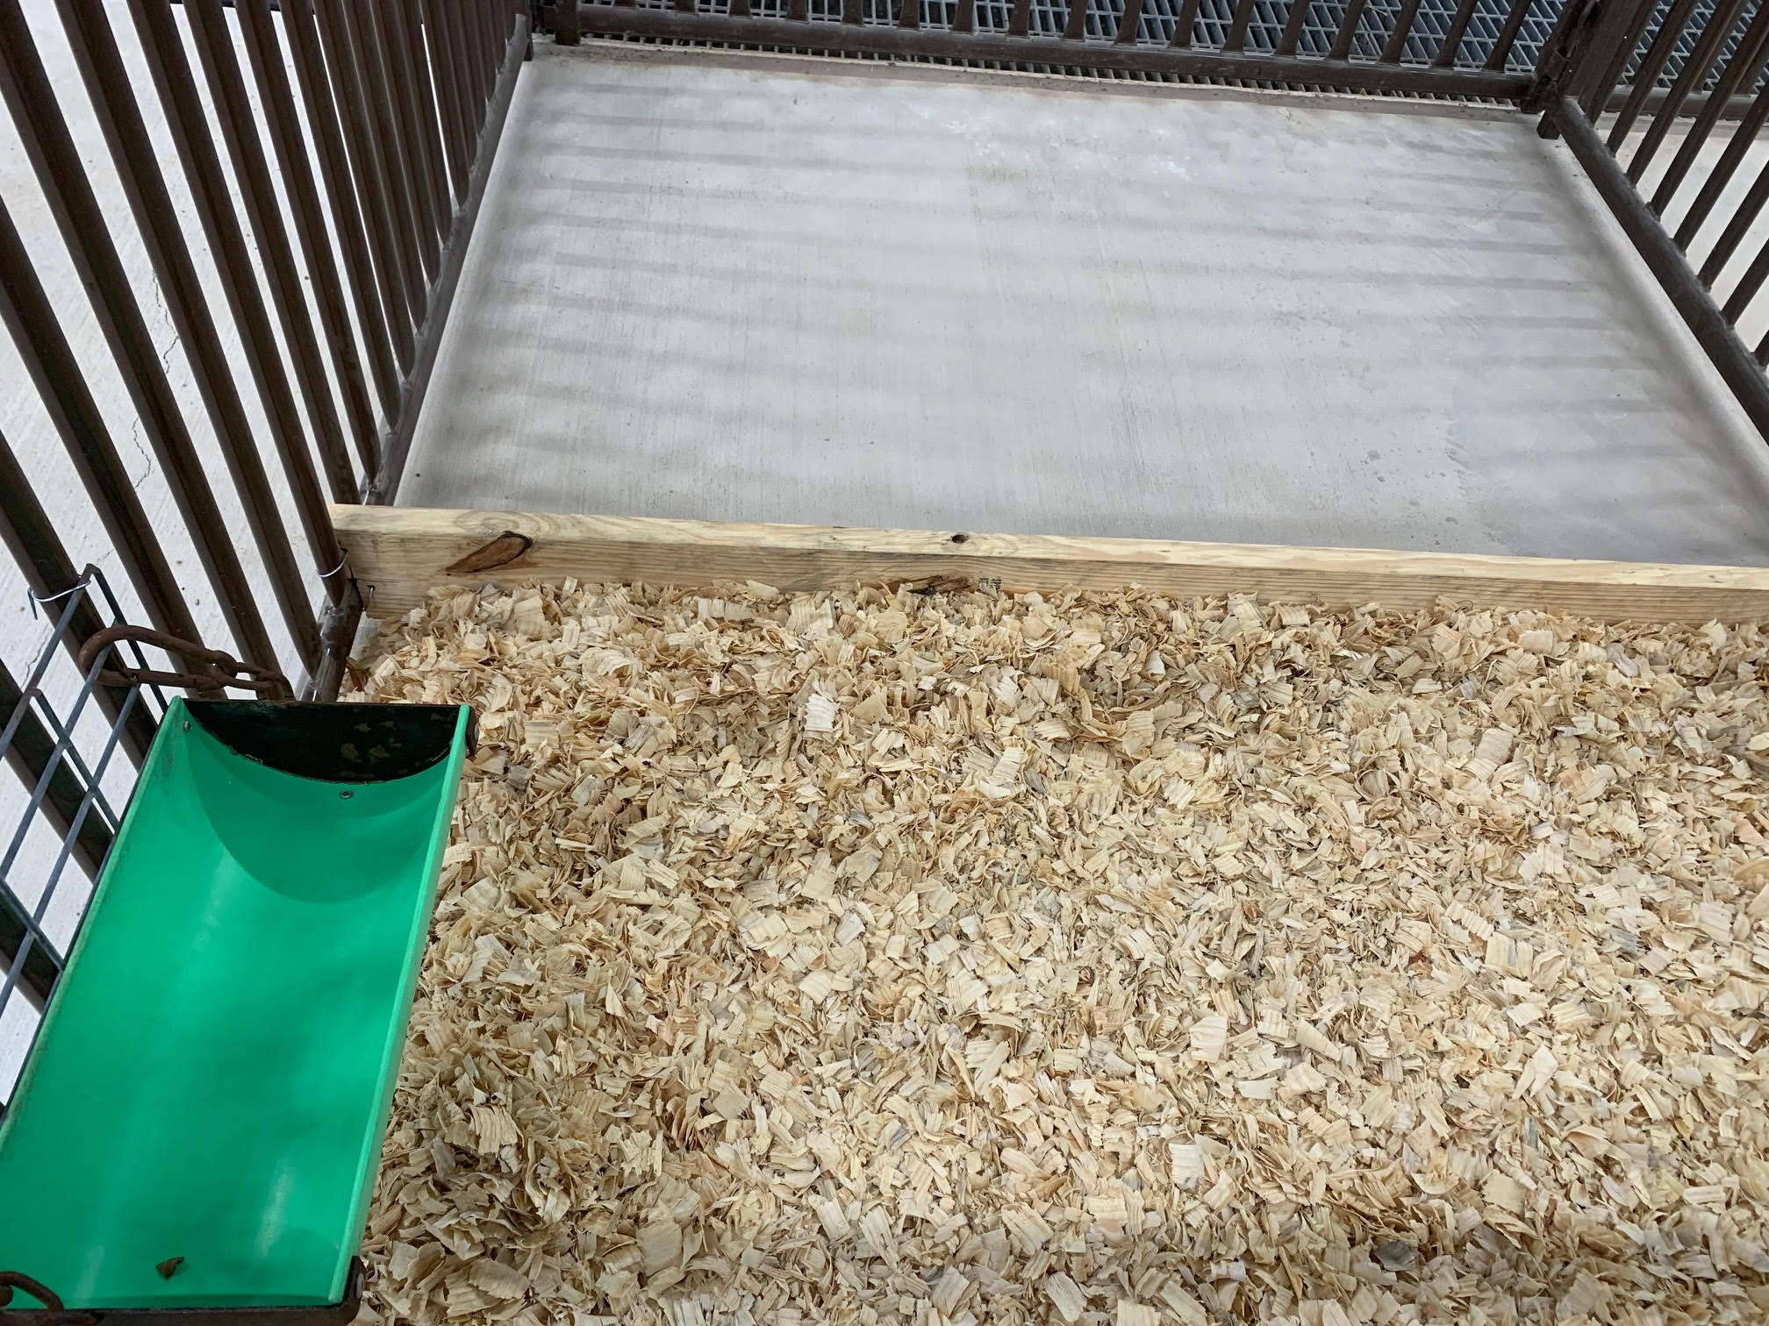
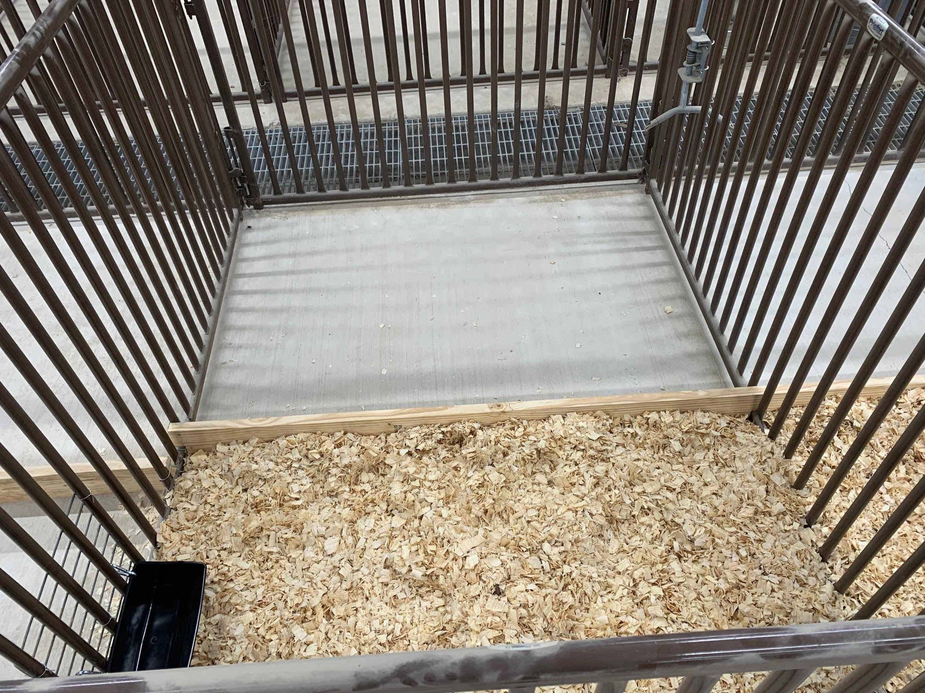
Clean pens daily
Keep your pens cleaned inside and outside of the pens

Slide 6
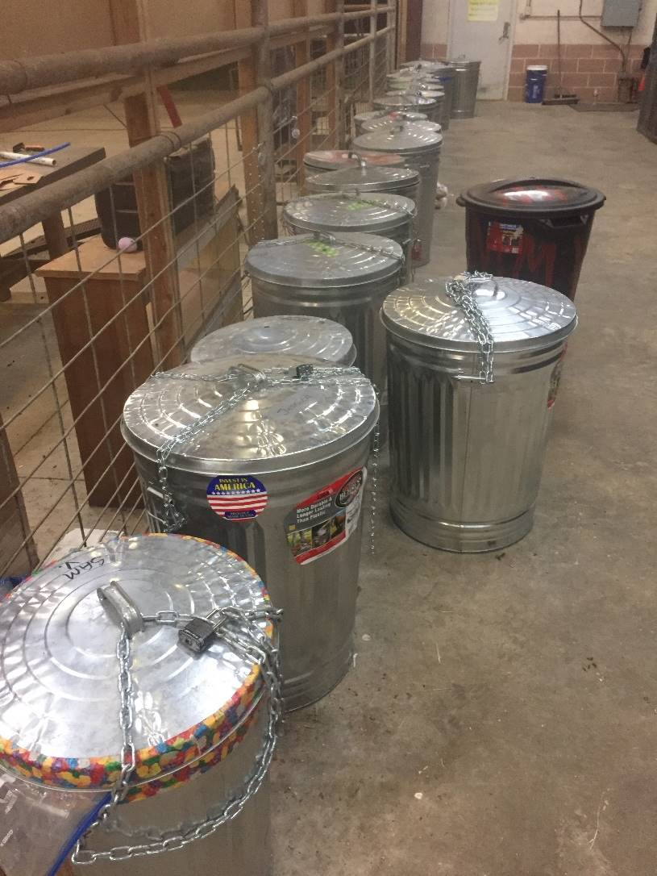
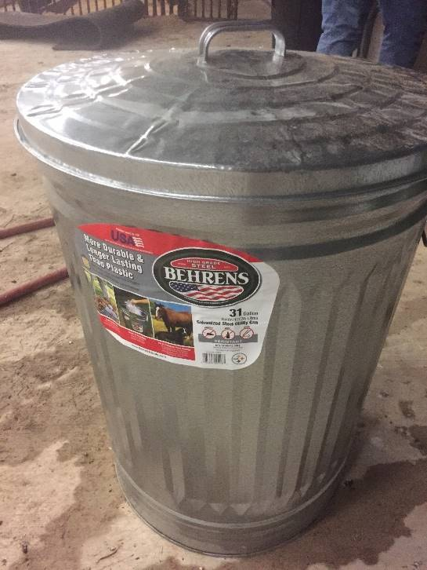
Lockable Supply Box and Feed Can
***Trash cans MUST BE METAL for feed storage
Chain & lock for trash can.
These items can be purchased at: Tractor Supply, Home Depot, Wal-Mart, etc.

Slide 7
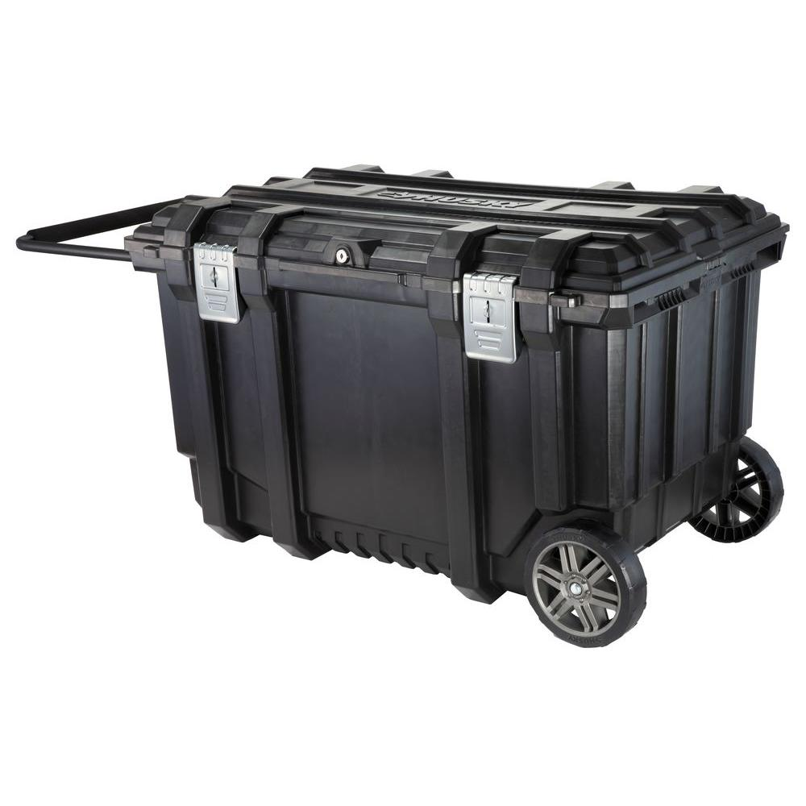
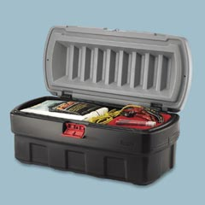
Lockable Supply Box…
Any box to lock your show supplies up at the barn.
Home Depot – 37” Mobile Job Box
Use a lock to secure the top

Slide 8
Feed Scoop
Cost $5
Any feed store, Sullivan Show Supply
Recycle an old coffee can – it works too!

Slide 9
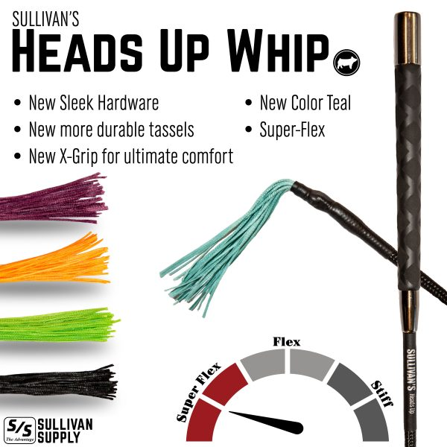
Practice Show Stick
Springlike whipping action
Made of Fiberglass
Trains the pig to keep their head up
Cost $30+
Most feed stores, Sullivan Show Supply

Slide 10
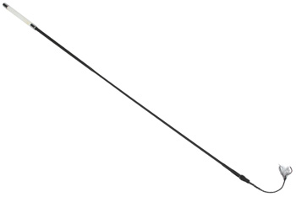
Show Stick
actual show day stick
Firm compared to practice show stick
Cost $15+
Sullivan Show Supply

Slide 11
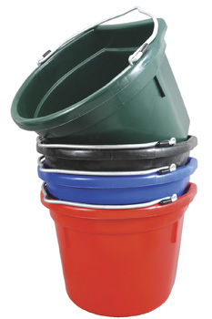
Feed Bucket
You need this for mixing feeds
Cost $5
Any feed store, Sullivan Show Supply

Slide 12
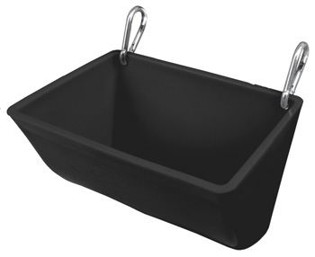
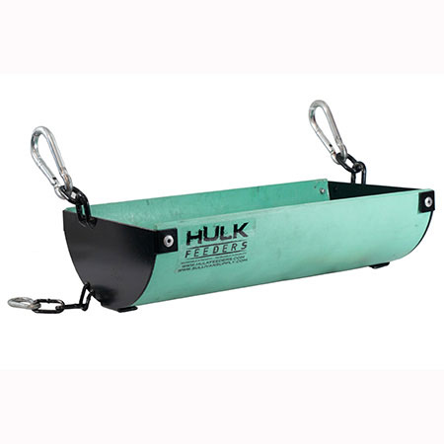
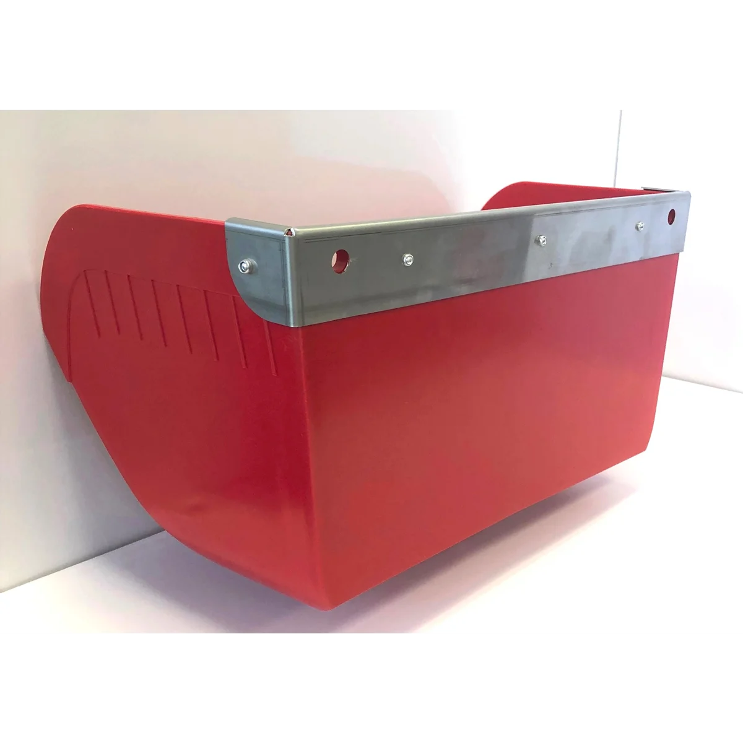
Clip on Feeder
This is the main feed trough you will use to feed your pig.
Harder for the pig to flip over
Cost $16+
Any feed store will carry this minimum 18” wide, Sullivan Show Supply
Hulk Feeder – Quality
Kane Feeder - Quality

Slide 13
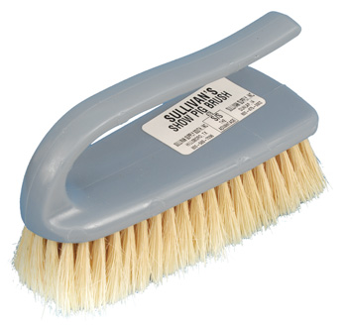
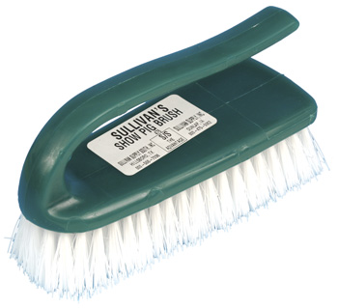
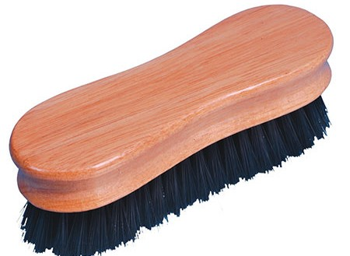
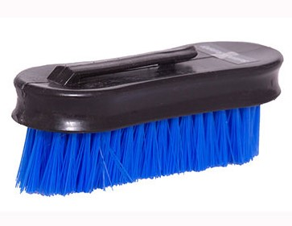
Brushes
You will need to use this to clean your pig and show with…
Get 2 – face brush(soft) and a body brush (firmer)
Cost $10 ea
Obtain from-Feed Store, Sullivan Show Supply, Tractor Supply
Body Brushes
Small hand-held face brushes

Slide 14
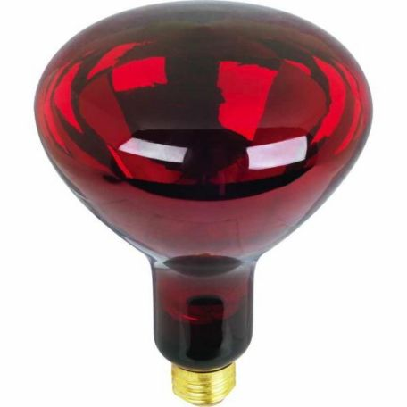
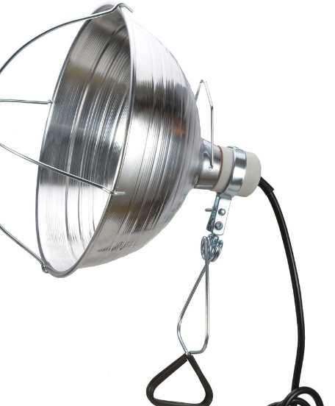
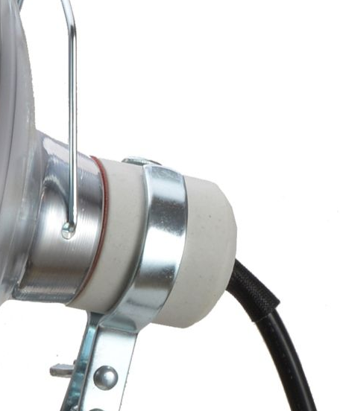
Heat Lamp – BUY NOW DO NOT WAIT until it gets cold!!
Use heat lamp in 45° weather or below.
Cost $9 @ Tractor Supply
250 Watt Bulb- $5.50 - white or red bulb is fine
PRO TIP – Buy EXTRA bulbs now.
**If you buy this type… Be sure the heat lamp has a ceramic light socket- NOT PLASTIC**
**Be sure to turn off/ unplug heat lamps during the day when temperatures are above 60°
Premier Sheep supplies

Slide 15
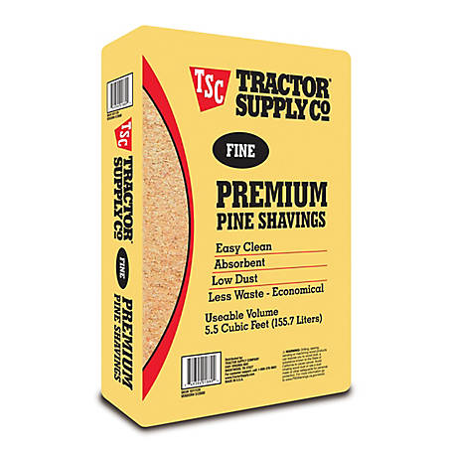
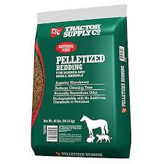
Pine Shavings (bedding)
You will need to change shavings out each week
Get the FLAKE bags
Cost $6.50/ bag @ Tractor Supply
DO NOT BUY THESE

Slide 16
CVS, Walgreens, Target
Spray Bottle
Hand Lotion
Shampoo – cheap
Conditioning your pig’s skin and hair
You will fill the spray bottle 1/2 way with lotion and the other 1/2 with water. Mix and shake well to mix it up. Spray this on the pigs skin each day and work the lotion mix into the skin. If the mixture is too thick, add more water.
WASH YOUR PIG AT LEAST 2-3 TIMES EACH WEEK!!
Grab a bottle of shampoo and do a deep wash; scrub all over the pig, top, sides, underbelly, etc.
Rinse thoroughly

Slide 17
What do I feed?
Lindners pig Feed – Grower of at least 18%
Use this site to help with feeding tools: http://lindnerfeed.com/feedingtools.html
Hill Country Feed Store Carries Lindners. Start pigs on either 611 or 632
IF YOU HAVE ANY QUESTIONS, PLEASE ASK MR. LEMMONS FIRST.
How will we feed the pig? Answer- 2 times per day
Feed pigs at least 1 - 1½ pounds per feeding, (twice per day) once the pig arrives at the barn.
**Increase the feed as the pig gains weight. Maximum amount will vary, but at 250lbs the pigs should be eating 10-12lbs per day.
DO NOT BUY FEED AT TRACTOR SUPPLY

Slide 18
Feeding
Weigh your pig every Sunday evening AFTER THEY EAT, write it down and report the weight to Mr. Lemmons
Finisher feed 210 to 260 lbs
To determine this we have to evaluate each pig often. We are looking for muscling and fat (finish)
We evaluate the pigs at 45-60 days prior to show and 21 days prior to show
Check your show dates to verify Evaluation date above!!

Slide 19
Calculating average daily gain (ADG)
You can calculate how much your animal will weigh at a certain date in the future by a short calculation.
ADG can be calculated by taking the amount of weight an animal has gained since the last weight taken and dividing the weight by the number of days since that last weight.
Today’s weight – last weight / # of days since last weight
Example: 210 – 191/ 8 days = 2.375 lbs of wt gain per day
So if there are 21 days until your show you would multiply 2.375 and add it to today’s weight to get an approximate show weight.
2.375 x 21 = 49.875 + 210 = 259.875 lbs @ show.

Slide 20
Care for your Pig
Pay attention to your pig. For the 1st week, just allow it to get used to their new home.
If you notice any of the following for more than 1 day LET THE TEACHER KNOW: runny nose, coughing, wheezing when they breath and diarrhea.
Worm your pig every 21 days. You can add these to the feed or administer in their mouth if it is a liquid. Use any of the following wormers: Atgard or Safe-Guard. Use as directions indicate.

Slide 21
What are we looking for in a pig?
What am I looking for on selection day?
What is the judge looking for on show day?

Slide 22
Meat
Your animal is a Market Animal, which translates to “we want as much meat on that animal as possible with some fat (aka: finish) as well!!”
The best hogs are the ones with the most lean muscle!

Slide 23
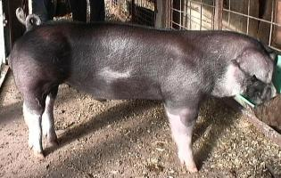
We want a large frame
Body Length

Slide 24
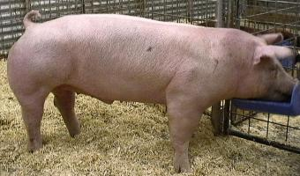
Heavy or thick Bones

Slide 25
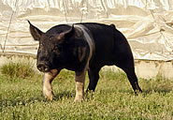
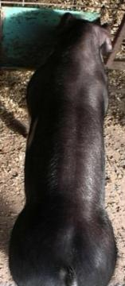
Wide Body Over base and top.

Slide 26
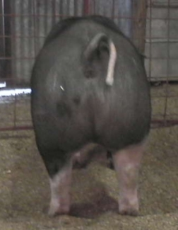
Wide & Deep Rear End

Slide 27
Muscular Back

Slide 28
Where are the feed stores?
Hill Country Feed *Local and gives an FFA discount on feed
909 South Highway 183 (Bell Road)
Leander, TX 78641
512-259-1658
Open Mon-Sat 8am-6pm, Sunday 10am-3pm
Hutto Feed
104 S. FM 1660
Hutto, TX
512-642-3522
Open Mon-Fri 7:30am-6pm, Saturday 8am-3pm
You can shop online as well, but try to support local feed dealers... www.sullivansupply.com

Slide 29
CALL AHEAD
Feed stores run out of feed, so to save you a trip call ahead ☺
Tell them in advance what you are going to be feeding and ask them to keep it in stock!

